Slide 1
Implementation of mobile health clinics for medically underserved communities through the use of the practical robust implementation and sustainability model (PRISM)
Tudor Firica PharmD Candidate 2022, Kevin Cleveland PharmD, Christopher Owens PharmD MPH, Nathan Spann PharmD, Elaine Nguyen PharmD MPH

Slide 2
Abstract
Introduction: This work describes the implementation of sustainable mobile health clinics to deliver vaccinations and other healthcare services (blood pressure, cholesterol, vision, etc.) to underserved populations.
Methods: The Practical Robust Implementation and Sustainability Model (PRISM) was used to guide dissemination and implementation of mobile health clinics. Process components were categorized using PRISM’s four key domains: Program (Intervention), External Environment, Implementation and Sustainability Infrastructure, and Recipients, allowing analysis of implementation of mobile health clinics to refine future approaches.
Results: Using PRISM, we were able to systematically identify key elements within the model’s four domains, from an organizational perspective and a patient perspective, such as liability, language barriers, community partners, funding, staff incentives, and demographics.
Conclusions: Using PRISM, key factors were identified in designing a pharmacist-led mobile health clinic and allowing us to translate evidence-based practices for dissemination and implementation of a sustainable mobile health clinic.

Slide 3
Introduction
Delivery of healthcare services to the underserved is especially challenging in rural states like Idaho.
Idaho has recognized these factors and is funding mobile vaccination clinics
Vaccination clinics also provide an opportunity for other health services

Slide 4
Introduction
Objective: Disseminate innovations in the mobile health clinics as a model for the implementation of sustainable community health programs.

Slide 5
Methods

Slide 6
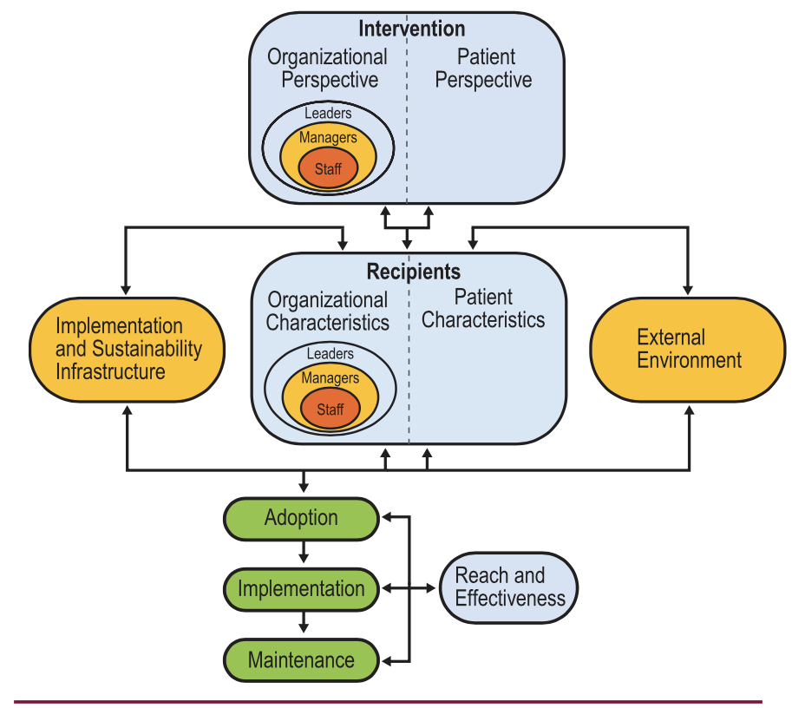
The Practical, Robust Implementation and Sustainability Model (PRISM)
Feldstein AC, Glasgow RE. A Practical, Robust Implementation and Sustainability Model (PRISM) for Integrating Research Findings into Practice. Jt Comm J Qual Patient Saf. 2008;34(4):228-243. doi:10.1016/S1553-7250(08)34030-6

Slide 7
Clinic Set Up
Clinic staff is composed of pharmacists and trained pharmacy students
Screening equipment was provided by Idaho State University College of Pharmacy
J&J and Moderna vaccinations provided
Point of care services provided
Blood pressure screening
Blood glucose screening

Slide 8
Data Collection
93 health screenings performed
45 vaccinations administered
Patient Satisfaction
14-item questionnaire given to patients
Questionnaire was adapted from the Patient Satisfaction Question Questionnaire Short Form (PSQ-18) from Rand Health

Slide 9
Data Collection
Organizational perspective captured by clinic reflection forms
What worked well at today’s clinic?
Why did it work well?
What were some challenges?
Possible solutions?

Slide 10
Results

Slide 11
PRISM Domains |  | Elements
Intervention | Organizational Perspective | · Target underserved populations for vaccine intervention · Funding provided by state · Easy to set up and take down clinics · Time to train staff · Liability Insurance
 | Patient Perspective | · Patient centered clinics · Language barriers · Location burden · Time burden · Health services
External Environment |  | · Community partners · Vaccination misinformation · COVID-19 rates · ISU’s community perception
Implementation and Sustainability |  | · Funding · Team training · Team burnout/workload · Idaho State University and Idaho Immunization Coalition support · Data collection / QI process
Recipients | Organizational Perspective | · Financial health · Staff history · Staff morale · Clinical Leadership · Management support and leadership · Staffing incentives · Goals
 | Patient Perspective | · Demographics · Disease burden · Knowledge and beliefs

Slide 12
Future of Pharmacy
Pharmacists are they key in filling in gaps left in the healthcare system

Slide 13
Conclusion
Using PRISM, key factors were identified in designing a mobile health clinic and allowing us to translate evidence-based practices for dissemination and implementation of a sustainable mobile health clinic.

Slide 14
References
1. Staff I of M, Millman ML. Access to Health Care in America. National Academies Press; 1993.
2. Access to Health Services | Healthy People 2020. Accessed July 21, 2021. https://www.healthypeople.gov/2020/topics-objectives/topic/Access-to-Health-Services
3. Núñez A, Sreeganga SD, Ramaprasad A. Access to Healthcare during COVID-19. Int J Environ Res Public Health. 2021;18(6):2980. doi:10.3390/ijerph18062980
4. Rural Health and Underserved Areas | Idaho Department of Health and Welfare. Accessed July 21, 2021. https://healthandwelfare.idaho.gov/providers/rural-health-and-underserved-areas/rural-health-and-underserved-areas
5. Bradley EH, Webster TR, Baker D, et al. Translating Research into Practice: Speeding the Adoption of Innovative Health Care Programs. :13.
6. Damschroder LJ. Clarity out of chaos: Use of theory in implementation research. Psychiatry Res. 2020;283:112461. doi:10.1016/j.psychres.2019.06.036
7. RE-AIM – Reach Effectiveness Adoption Implementation Maintenance. Accessed July 21, 2021. https://www.re-aim.org/
8. Feldstein AC, Glasgow RE. A Practical, Robust Implementation and Sustainability Model (PRISM) for Integrating Research Findings into Practice. Jt Comm J Qual Patient Saf. 2008;34(4):228-243. doi:10.1016/S1553-7250(08)34030-6

